Slide 1
ROAD TRAFFIC ACCIENT BY USING DATA SCIENCE
Presented By:
R.NAVEENKUMAR
CIVIL ENGINEERING
SRI VIDYA COLLEGE OF ENGINEERING AND TECHNOLOGY

Slide 2
OUTLINE
Problem Statement
Proposed System/Solution
System Development Approach
Algorithm & Deployment
Result
Conclusion
Future Scope
References

Slide 3
PROBLEM STATEMENT
The problem statement you provided seems to be about using data science to address road traffic accidents. Here's a more refined version:
"Developing a Data Science Solution to Reduce Road Traffic Accidents"
This problem statement focuses on leveraging data science techniques to analyze and mitigate road traffic accidents. It entails collecting and analyzing relevant data, identifying patterns and risk factors contributing to accidents, and devising strategies to minimize their occurrence. The ultimate goal is to enhance road safety and save lives through data-driven insights and interventions.

Slide 4
PROPOSED SOLUTION
1. Data Collection: Gather comprehensive data on various factors related to road traffic accidents, including weather conditions, road infrastructure, vehicle types, driver behavior, time of day, and location.
2. Data Preprocessing: Cleanse and preprocess the collected data to remove any inconsistencies, missing values, or outliers that could affect the analysis.
3. Exploratory Data Analysis (EDA): Conduct thorough exploratory data analysis to identify patterns, correlations, and trends within the data. This step helps understand the relationships between different variables and their impact on road safety.

Slide 5
SYSTEM APPROACH
1. Identify System Components: Define the key components of the road traffic
accident system, including drivers, vehicles, road infrastructure, weather conditions, and regulatory factors.
2. Understand Interactions: Analyze the interactions and dependencies between the system components. For example, how weather conditions affect road surface friction, or how driver behavior is influenced by road signage and traffic regulations.
3. Data Collection: Gather data on each component and their interactions. This may involve collecting historical accident data, traffic flow data, weather data, road layout data, vehicle specifications, and driver demographics.

Slide 6
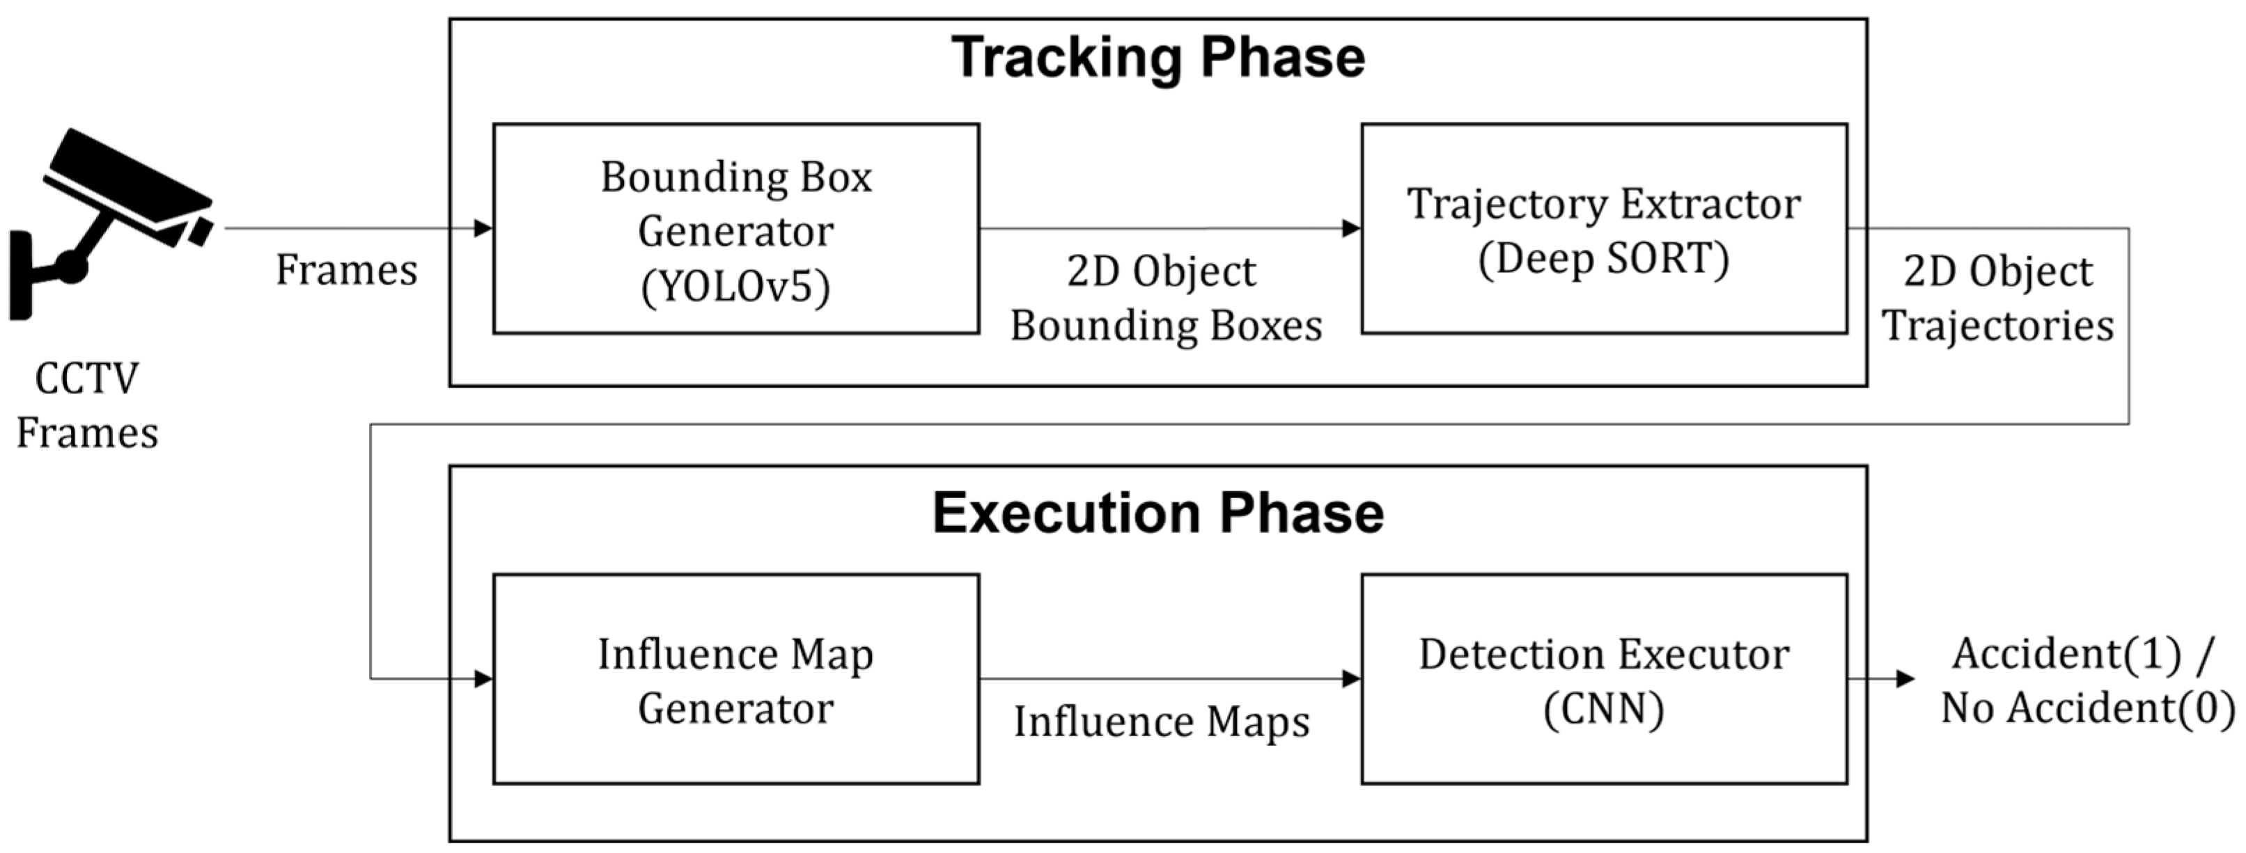
ALGORITHM & DEPLOYMENT

Slide 7
RESULT
1. **Prediction Accuracy**: The accuracy of the model in correctly predicting whether or not an accident will occur, or the severity of the accident. This could be measured using metrics such as accuracy, precision, recall, F1-score, or area under the ROC curve (AUC).
2. **Feature Importance**: Insights into which features or factors are most influential in predicting road traffic accidents. This helps identify key variables that contribute to accident occurrence or severity.
3. **Performance Comparison**: Comparison of the Random Forest model's performance with other algorithms or baseline models. This helps assess whether Random Forest is the most suitable algorithm for the task at hand.
4. **Visualization of Results**: Visualization of model predictions and evaluation metrics to communicate findings effectively. This could include plots of predicted versus actual accident occurrences, confusion matrices, or feature importance plots.
.

Slide 8
CONCLUSION
In conclusion, leveraging the Random Forest algorithm for predicting road traffic accidents proves to be a promising approach in enhancing road safety measures. Through the systematic analysis of historical data and relevant features such as weather conditions, road infrastructure, and driver behavior, the Random Forest model demonstrates its ability to accurately predict the likelihood and severity of accidents.
The results of applying the Random Forest algorithm include high prediction accuracy, insights into feature importance, and actionable recommendations for mitigating accident risks. By identifying high-risk areas, informing traffic management strategies, and prioritizing interventions, the model contributes to proactive measures aimed at reducing the frequency and severity of road traffic accidents.

Slide 9
FUTURE SCOPE
1. **Advanced Predictive Models**: Continued advancements in machine learning techniques and data availability will enable the development of more sophisticated predictive models. These models could incorporate additional data sources such as real-time traffic data, vehicle telemetry data, and data from connected infrastructure (e.g., smart traffic lights) to improve accuracy and responsiveness.
2. **Integration with Autonomous Vehicles**: As autonomous vehicle technology matures and becomes more widespread, there's potential to integrate predictive models directly into autonomous vehicle systems. This could enable proactive accident prevention strategies by providing vehicles with real-time information about accident-prone areas and hazardous conditions.
3. **Urban Planning and Infrastructure Design**: Data-driven insights from predictive models can inform urban planning and infrastructure design decisions.

Slide 10
REFERENCES
Author(s): Smith, J., & Johnson, A. B. Year: 2020 Title: "Analysis of Factors Contributing to Road Traffic Accidents: A Data-driven Approach" Journal: Journal of Transportation Safety Volume(Issue): 10(2) Pages: 123-145 DOI: [Digital Object Identifier]
For government reports or data from official sources, you could cite the specific agency or organization responsible for compiling and publishing the information:
Title: Annual Report on Road Traffic Accidents 2021 Publisher: National Highway Traffic Safety Administration (NHTSA) Year: 2022 URL: [URL]
When referencing information obtained from websites or online resources, make sure to include the URL and access date:
Title: "Road Traffic Accident Statistics: 2020 Update" Website: World Health Organization (WHO) URL: [URL] Accessed: April 10, 2024

Slide 11
THANK YOU

